Slide 1
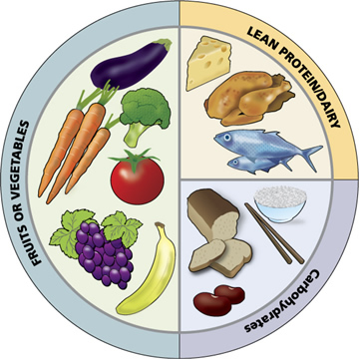
Nutrition
Digestive System Day 5

Slide 2
Nutrition and Nutrients
Nutrition:
Study of nutrients and how the body utilizes them
Nutrients:
6 Kinds
Include: Carbs, lipids, proteins, vitamins, minerals and water

Slide 3
Other Key Terms
Macronutrients
Carbs, Lipids, Proteins
Are required in large amounts
Provide energy and other specific functions
Micronutrients
Vitamins and Minerals
Are required in small amounts
Do not provide energy but aid the chemical reactions needed to extract energy from macronutrients

Slide 4
Calories
Potential energy from macronutrients, units of heat
Definition: the amount of heat required to raise the temperature of a gram of water by 1 degree celsius.
Calorie used to measure food is 1000x greater, actually a kilocalorie
Cellular oxidation yields calories
1 g. of Carbs. or Proteins = 4.1 Cal.
1 g. of Fat = 9.5 cal.

Slide 5
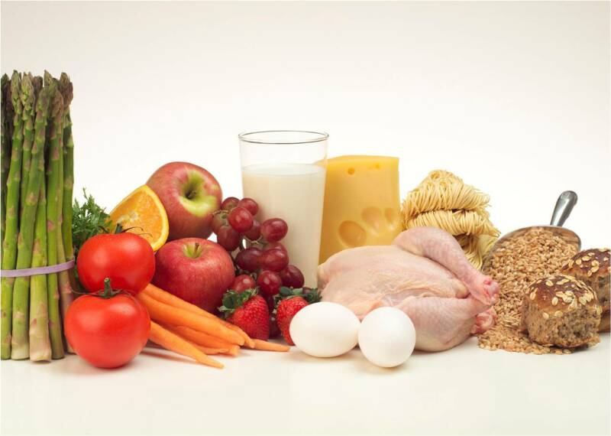
Essential Nutrients
Nutrients that the human cells cannot synthesis (produce) therefore you eat them in your food.
Example
Carbs.
Lipids
Proteins
Vitamins
Minerals
Water

Slide 6
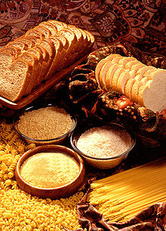
Carbohydrates
Organic compounds that include the sugars and starches
Energy held in the chemical bonds is primarily used to power cellular processes.

Slide 7
Carbohydrate Sources
Starch
Grains and vegetables
Glycogen
Meats
Disaccharides
Milk sugar, cane sugar, beet sugar, molasses
Monosaccharides
Honey and fruits
Digestion breaks down all these so they can be absorbed easily

Slide 8
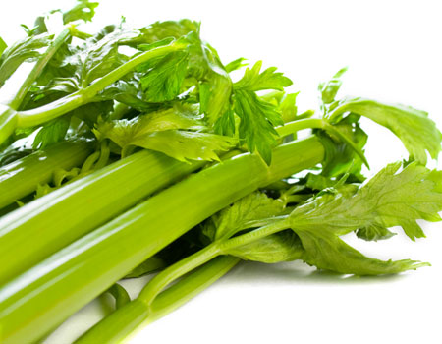
Carbohydrate Sources Cont.
Cellulose…Fiber…Roughage
Complex, found in celery and lettuce
Can’t be digested
Needed because it provides bulk against which the muscular wall of the digestive system can push, easing the movement of the intestinal contents

Slide 9
Carbohydrate Use
All sugars are converted to glucose by the liver so the body can obtain cellular fuel
Excess glucose is converted to glycogen to be stored in the liver and muscles but only a certain amount can be stored, all other gets converted to fat and stored as adipose tissue
To obtain energy the body first uses metabolized glucose, then stored glycogen, then fats and proteins

Slide 10
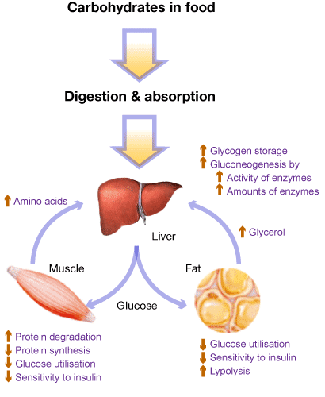
Carbohydrate Use Cont.
Also needed to make RNA and DNA
Required to produce lactose (milk sugar) when breasts are actively secreting milk

Slide 11
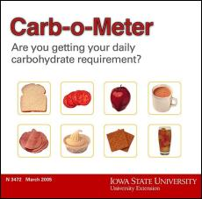
Carbohydrate Requirements
Needs depend on individuals energy expenditure
The more physically active, the more carbs. you need
Minimal requirement is unknown but estimated intake is 125-175 grams daily
This prevents protein breakdown and metabolic disorders from excess fat use.

Slide 12
Lipids
Organic compounds that include fats, oils, and fatlike substances such as phospholipids and cholesterol
Supply energy for cellular processes and help build structures such as cell membranes
Most Common
triglycerides

Slide 13
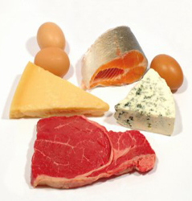
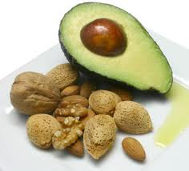
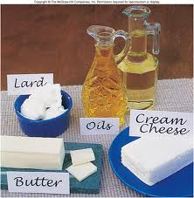
Lipid Sources
Triglycerides
Found in plant and animal-based foods
Saturated Fats
Mainly found in animal food origins
Meat, eggs, milk, lard
In excess, lead to cardiovascular disease
Unsaturated Fats
Found in plant food origins
Seeds, nuts, plant oils
Healthiest
Cholesterol
Not present in foods of plant origin
Liver, egg yolk, whole milk, butter, cheese, meats

Slide 14
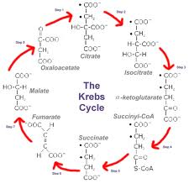
Lipid Use
Supply variety of physiological functions
Mainly supply energy
During digestion, lipids are broken down into fatty acids and glycerol
Once absorbed, travels though lymph and then to tissues
Used greatly by Cellular Respiration process
Fat molecules are stored in adipose tissue

Slide 15
Lipid Use Cont.
Liver converts fatty acids from one form to another but cannot produce all of them
Essential Fatty Acids
Linoleic Acid
Required for phospholipid synthesis
Corn, cottonseed, soy oils are good sources
Lipoproteins
Helps regulate cholesterol levels
LDL, HDL

Slide 16
Lipid Requirements
Amounts and type of fats required vary with individuals habits and goals
Recommendation is to not exceed 30% of calories
Adds flavor to food which explains low fat diets are difficult
Need fat to dissolve fat-soluble vitamins
Babies need the most to prevent deficiency conditions

Slide 17
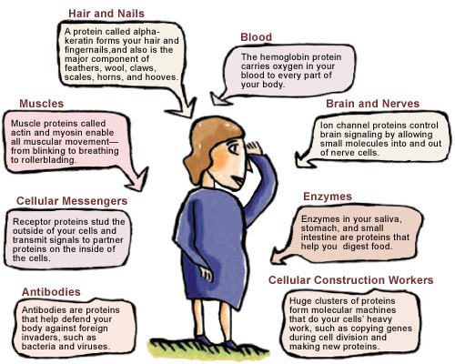
Proteins
Polymers of amino acids and involved in a wide variety of functions

Slide 18
Protein Sources
Meats, fish, poultry, cheese, nuts, milk, eggs, and cereals are high in protein
Legumes-beans and peas-are less
Essential Amino Acids
Adults produce all but 8
Children all but 10
Must be taken in with diet
vs Nonessential-Produced by body
See table 15.7 on page 431

Slide 19
Protein Sources Cont.
All 20 amino acids must be present in body at the same time for growth and tissue repair to occur
Protein synthesis doesn’t occur without all 20 present
Complete Proteins-foods that contain all 20 amino acids
Milk, meats, eggs
Incomplete Proteins-foods that are unable to maintain human tissues or support human growth and development by themselves
Corn
Partially Complete-Has all 20 but not in correct amounts
wheat

Slide 20
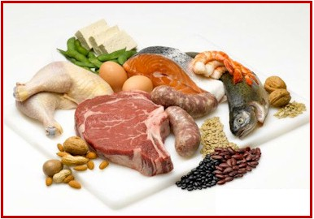
Protein Use
Include
Enzymes
Control metabolic rates
Clotting factors
Keratin of skin and hair
Elastin and collagen of connective tissue
Plasma proteins that regulate water balance
Muscle components actin and myosin
Certain hormones
Antibodies that protect against infection
Also supply energy after digestion breaks them down into amino acids

Slide 21
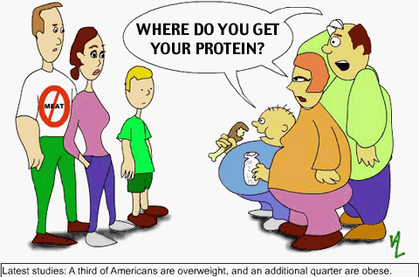
Protein Requirements
Varies depending on:
Body size
Metabolic rates
Activity level
Etc.
Avg. adult intake should be 60-150 grams per day
Pregnant women need 30 more grams
Nursing mothers require 20 more g.

Slide 22
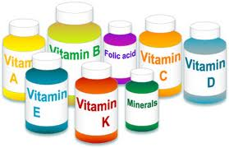
Vitamins
Organic compounds required in small amounts for normal metabolism, that cells cannot produce in adequate amounts
Classified based on solubility
Some dissolve in fats
A, D, E, K
Some dissolve in water
B Vitamins and Vit. C

Slide 23
Fat-Soluble Vitamins
A
D
Dissolve in fats therefore are associated with lipids and respond the same way
Resist heat so are not broken down when cooked
Accumulate which when taken in excess can lead to overdose
Too much beta carotene (Vit. A) leads to orange tinged skin
SEE TABLE 15.8 on Page 432
E
K

Slide 24
Water-Soluble Vitamins
B-Vitamins
Essential for normal cellular metabolism
Oxidize carbohydrates, lipids, and proteins
Found in same types of foods so often called vitamin B complex
Cooking and food processing can destroy some
Vitamin C
Lease stable but widespread in plant foods
Necessary for collagen production, promotes iron abosorption
SEE TABLE 15.9 on Page 433

Slide 25
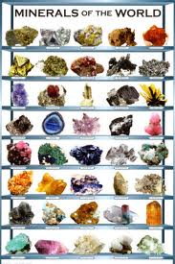
Minerals
Inorganic elements essential in human metabolism
Plants extract from soil so humans obtain from eating plants or eating animals that have eaten plants

Slide 26
Characteristics of Minerals
Contribute about 4% of body weight
Concentrated in bones and teeth
Part of structural materials of all body cells
Constitute part of enzyme molecules
Contribute to osmotic pressure of body fluids
Play a vital role in nerve impulse conduction, muscle fiber contraction, blood coagulation, and maintenance of pH of body fluids

Slide 27
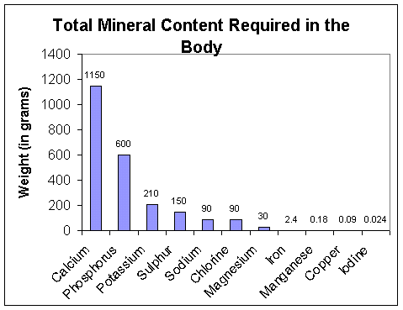
Major Minerals
Calcium and Phosphorus account for nearly 75% by weight of the mineral elements on body
Others which account for .05% or more are:
Potassium
Sulfur
Sodium
Chlorine
Magnesium
SEE TABLE 15.10 on page 434

Slide 28
Trace Elements
Essential minerals found in minute amounts
Make up less than .005% of adult body weight
Iron
Manganese
Copper
Iodine
Colbalt
Zinc
Fluorine
Selenium
Chromium
SEE TABLE 15.11 on page 435

Slide 29
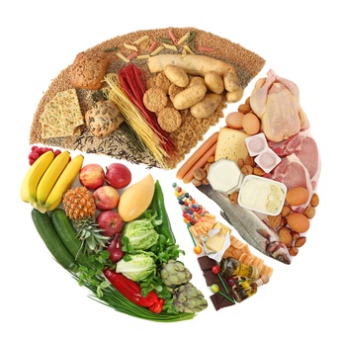
Adequate Diets
Provides sufficient energy (calories), essential fatty acids, amino acids, vitamins and minerals to support optimal growth and to maintain and repair body tissues.
Individual requirements depends on:
Age
Sex
Growth rate
Physical activity
Level of stress
Genetic and other environmental factors

Slide 30
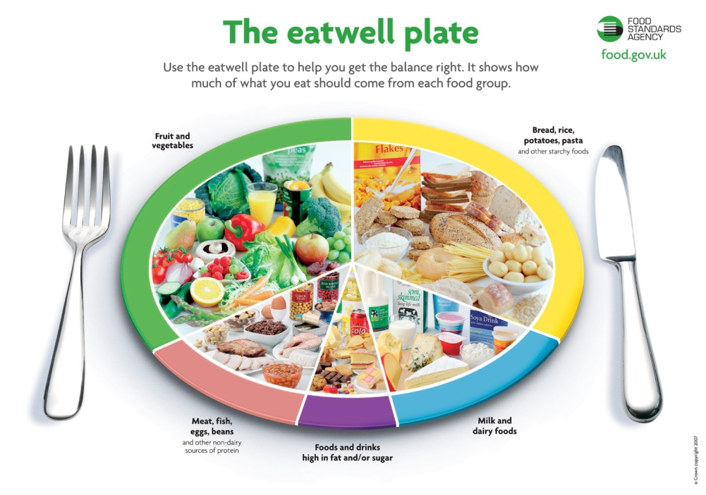
Adequate Diets Cont.
No diet that is adequate for everyone is possible
Diagrams like the food plate/pyramids help organize foods only according to suggested relative amounts

Slide 31
Adequate Diets
Malnutrition
Poor nutrition that results from a lack of nutrients or a failure to use them
2 types:
Undernutrition
Producing symptoms of deficiency disease
Overnutrition
Arising from excess nutrient intake
See clinical application 15.4 on page 436

Slide 32
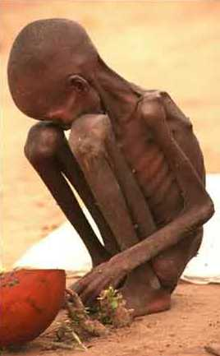
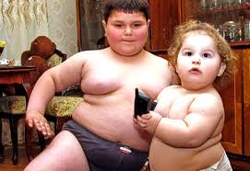
Adequate Diets Cont.
Causes of Malnutrition
Undernutrition
Lack of food
Poor quality of food
Overnutrition
Overeating
Taking too many vitamin supplements

Slide 33
Body Mass Index
Measurement used to determine whether a person is of adequate weight, overweight or obese
To calculate
Divide your weight in kilograms (2.2 pounds in 1 kilo) by your height in meters squared (1 foot is about .3 meters)
See figure 15.34 on Page 437 to see where you fall

